Slide 1
Operating System
Dr. Kaushal Shah
Assistant Professor
Computer Engineering
PDEU
The compilation of the PPTs is from the source:
All the different articles and research papers available on internet and NPTEL

Slide 2
Outline for Today
Popular OSs

Slide 3
Why Operating Systems?
OS for CSE :
Real world OS is a software engineering problem
Design of the Virtual/Extended machine
Development of the Kernel
OS Usability, Human Factors for OS
OS for CSE:
New algorithms to help make OS better, more efficient
Hypothesis, experiments regarding OS approaches
OS for anyone else :
Help to understand better the parts of the OS and how to compare and contrast the various qualities of Operating Systems

Slide 4
Popular types of OS
Desktop Class
Windows
OS X
Unix/Linux
Chrome OS
Server Class
Windows Server
Mac OS X Server
Unix/Linux
Mobile Class
Android
iOS
Windows Phone

Slide 5
Desktop Class Operating Systems:-
Platform: the hardware required to run a particular operating system
Intel platform (IBM-compatible)
Windows
DOS
UNIX
Linux
Macintosh platform
Mac OS
iPad and iPhone platform
iOS

Slide 6
Ms-DOS
Single User Single Tasking OS.
It had no built-in support for networking, and users had to manually install drivers any time they added a new hardware component to their PC.
DOS supports only 16-bit programs.
Command line user interface.
So, why is DOS still in use? Two reasons are its size and simplicity. It does not require much memory or storage space for the system, and it docs not require a powerful computer.

Slide 7

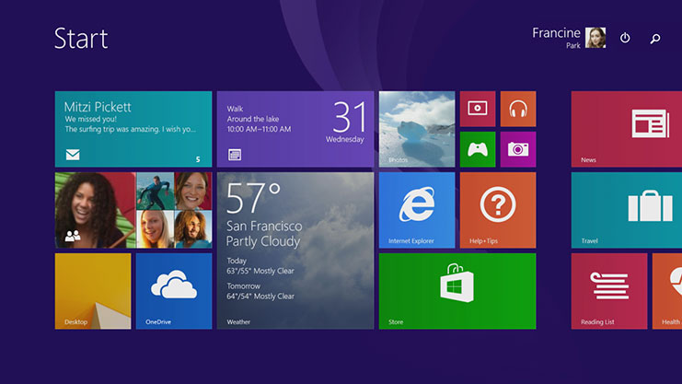
Microsoft Windows
The graphical Microsoft operating system designed for Intel-platform desktop and notebook computers.
Best known, greatest selection of applications available.
Current editions include Windows 7, 8, 8.1 and 10.

Slide 8
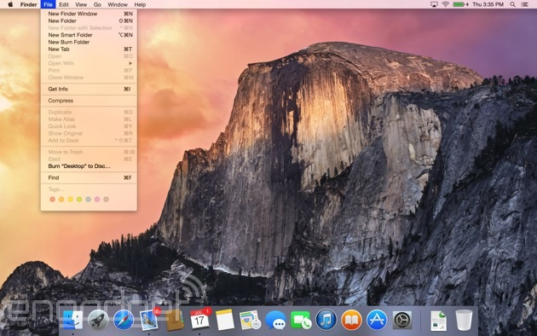
Mac OS
User-friendly, runs on Mac hardware. Many applications available.
Current editions include: Sierra, High Sierra, Mojave, Catalina & Big Sur—Version XI(Released in Nov 2020)

Slide 9

Linux
Linux: An open-source, cross-platform operating system that runs on desktops, notebooks, tablets, and smartphones.
The name Linux is a combination Linus (the first name of the first developer) and UNIX (another operating system.
Users are free to modify the code, improve it, and redistribute it,
Developers are not allowed to charge money for the Linux kernel itself (the main part of the operating system), but they can charge money for distributions (distros for short).

Slide 10

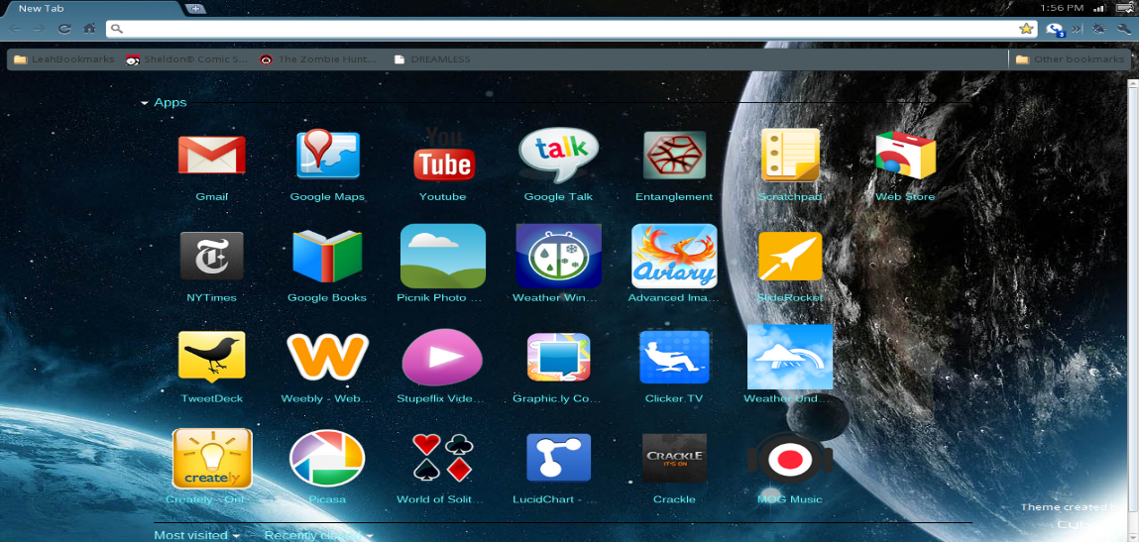
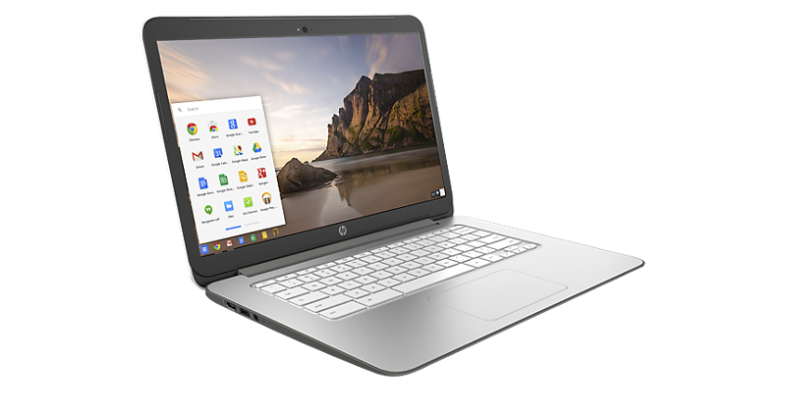

Google Chrome OS
Chrome OS. Is a popular thin client operating system.
Thin client A computer with minimal hardware, designed for a specific task. For example, a thin web client is designed for using the Internet.

Slide 11
Server Operating Systems
Windows Server
Familiar GUI interface for those experienced with Windows
UNIX
Very mature server capabilities, time-tested, large user community, stable
Linux
Free, customizable, many free services and utilities available

Slide 12
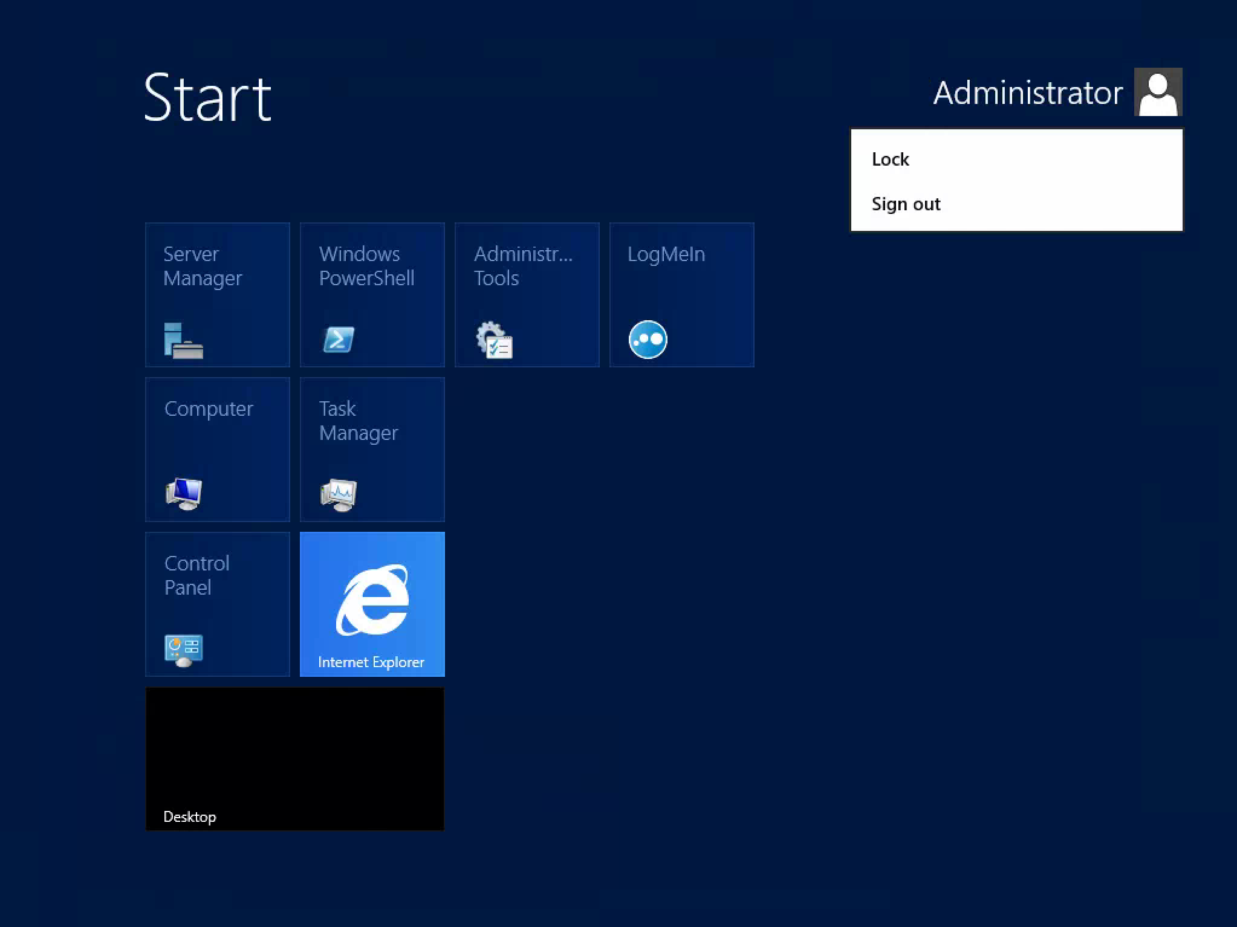
Windows Server

Slide 13
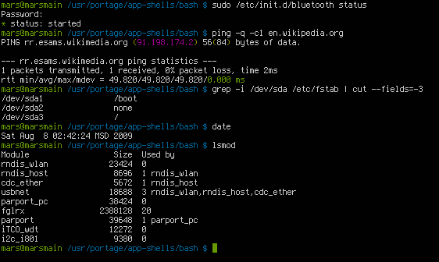
UNIX

Slide 14

Tablet and Phone Operating Systems
System-on-chip (SoC): An operating system that comes preinstalled on a chip on a portable device such as a smartphone.
Popular SoC operating systems:
iOS: for iPad, iPhone
Android: for a variety of tablets and phones
Downloadable applications (apps) from an App store, for example:
Apple App Store
Google Play Store

Slide 15
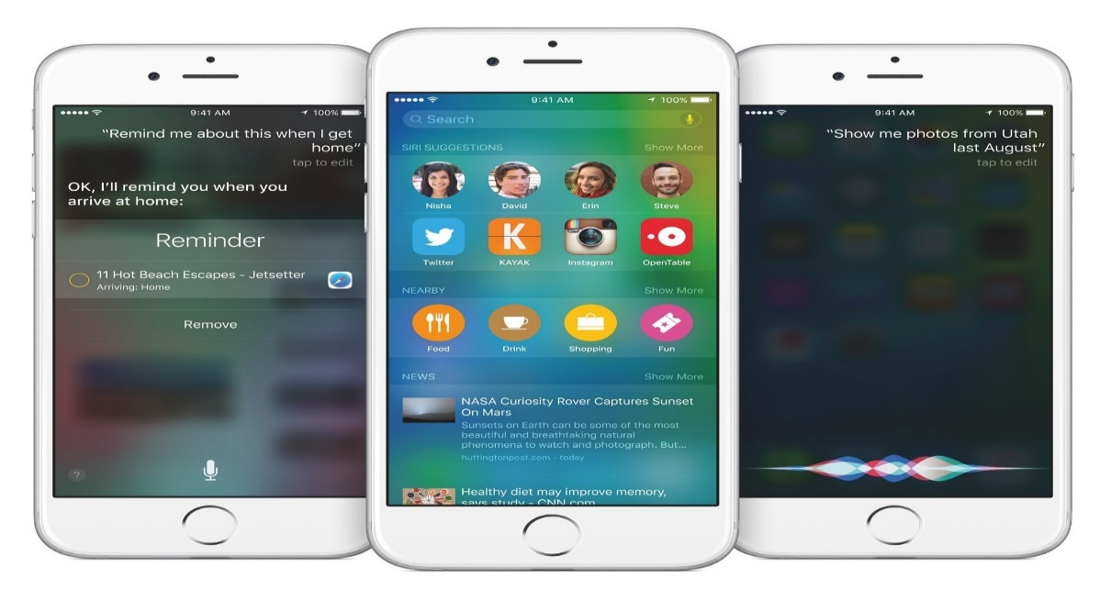
iOS on the iPhone and iPad
The Apple-created operating system for Apple tablets and phones.
The current stable version, iOS 14, was released to the public on September 16, 2020.

Slide 16



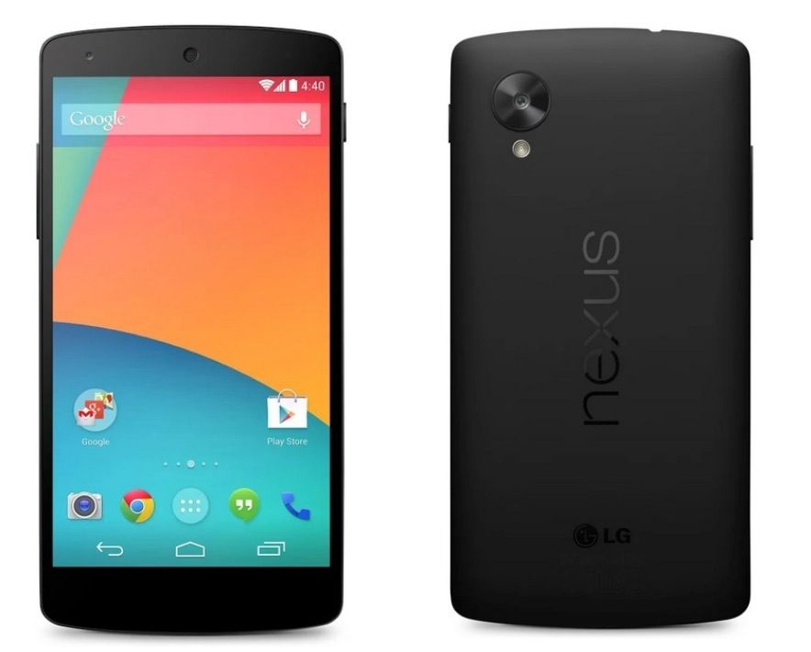
Android
Android, a popular OS for smartphones and tablets, is based on Linux Kernel.
Developed by Google
Current versions include:
Android 8 Oreo
Android 9 Pie
Android 10
Android 11 (released on Sep, 2020)

Slide 17
Advantage of Linux Operating System
1. Open Source
As it is open-source, its source code is easily available.
Anyone having programming knowledge can customize the operating system.
One can contribute, modify, distribute, and enhance the code for any purpose.
2. Security
The Linux security feature is the main reason that it is the most favourable option for developers.
It is not completely safe, but it is less vulnerable than others.
Each application needs to authorize by the admin user.
Linux systems do not require any antivirus program.
3. Free
Certainly, the biggest advantage of the Linux system is that it is free to use.
We can easily download it, and there is no need to buy the license for it.
It is distributed under GPL (General Public License).
Comparatively, we have to pay a huge amount for the license of the other OS

Slide 18
Advantage of Linux Operating System
4. Lightweight
The requirements for running Linux are much less than other operating system
In Linux, the memory footprint and disk space are also lower.
Generally, most of the Linux distributions required as little as 128MB of RAM around the same amount for disk space.
5. Stability
Linux is more stable than other operating systems.
Linux does not require to reboot the system to maintain performance levels.
It rarely hangs up or slow down. It has big up-times.

Slide 19
Advantage of Linux Operating System
6. Performance
Linux system provides high performance over different networks.
It is capable of handling a large number of users simultaneously.
7. Flexibility
Linux operating system is very flexible.
It can be used for desktop applications, embedded systems, and server applications too.
It also provides various restriction options for specific computers.
We can install only necessary components for a system.
8. Software Updates
In Linux, the software updates are in user control.
We can select the required updates.
There a large number of system updates are available.
These updates are much faster than other operating systems.
So, the system updates can be installed easily without facing any issue.

Slide 20
Advantage of Linux Operating System
9. Distributions/ Distros
There are many Linux distributions available in the market.
It provides various options and flavors of Linux to the users.
We can choose any distros according to our needs.
Some popular distros are Ubuntu, Fedora, Debian, Linux Mint, Arch Linux,
For the beginners, Ubuntu and Linux Mint would be useful.
Debian and Fedora would be good choices for proficient programmers.
10. Live CD/USB
Almost all Linux distributions have a Live CD/USB option.
It allows us to try or run the Linux operating system without installing it.
11. Graphical User Interface
Linux is a command-line based OS but it provides an interactive user interface like Windows.

Slide 21
Advantage of Linux Operating System
12. Suitable for programmers
It supports almost all of the most used programming languages such as C/C++, Java, Python, Ruby, and more.
Further, it offers a vast range of useful applications for development.
The programmers prefer the Linux terminal over the Windows command line.
The package manager on Linux system helps programmers to understand how things are done.
Bash scripting is also a functional feature for the programmers.
It also provides support for SSH, which helps in managing the servers quickly.
13. Community Support
Linux provides large community support.
We can find support from various sources.
There are many forums available on the web to assist users.
Further, developers from the various open source communities are ready to help us.

Slide 22
Advantage of Linux Operating System
14. Privacy
Linux always takes care of user privacy as it never takes much private data from the user. Comparatively, other operating systems ask for the user's private data.
15. Networking
Linux facilitates with powerful support for networking. The client-server systems can be easily set to a Linux system. It provides various command-line tools such as ssh, ip, mail, telnet, and more for connectivity with the other systems and servers. Tasks such as network backup are much faster than others.
16. Compatibility
Linux is compatible with a large number of file formats as it supports almost all file formats.
17. Installation
Linux installation process takes less time than other operating systems such as Windows. Further, its installation process is much easy as it requires less user input. It does not require much more system configuration even it can be easily installed on old machines having less configuration.

Slide 23
Advantage of Linux Operating System
18. Multiple Desktop Support
Linux system provides multiple desktop environment support for its enhanced use. The desktop environment option can be selected during installation. We can select any desktop environment such as GNOME (GNU Network Object Model Environment) or KDE (K Desktop Environment) as both have their specific environment.
19. Multitasking
It is a multitasking operating system as it can run multiple tasks simultaneously without affecting the system speed.
20. Heavily Documented for beginners
There are many command-line options that provide documentation on commands, libraries, standards such as manual pages and info pages. Also, there are plenty of documents available on the internet in different formats, such as Linux tutorials, Linux documentation project, Serverfault, and more. To help the beginners, several communities are available such as Ask Ubuntu, Reddit, and StackOverflow.

Slide 24
UNIX Shell and Utilities
User
The shell used to be in the kernel but now is a utility outside of it.
Easy to change/debug.
Many of them (sh, bsh, csh, ksh, tcsh, wsh, bash)
Possible to switch between them (chsh)
Utilities
Shell
Kernel
Hardware

Slide 25
Questions???

